Slide 1
$
#
↗
RETAIL SALES
ANALYTICS
Business Intelligence & Data Analytics Capstone
PRESENTED BY KAVINPRASATH.R
Excel • SQL • Python • Power BI

Slide 2
Executive Overview
02
A concise view of the retail dataset and measurable business outcomes.
$
$8.58M
#
1,615
↗
7,078
C
1,445
Total Revenue
Orders
Units Sold
Customers
Source transaction data
Distinct orders
Total item quantity
Unique customers in orders
KEY SIGNALS
DATASET SCALE
✓
What the analysis shows
P
321
S
939
• 2017 delivered the highest annual revenue at $3.85M.
• Mountain Bikes generated $3.03M, the leading category.
• Baldwin Bikes contributed $5.83M, about 67.9% of revenue.
• The dashboard highlights 307 low-stock items for inventory attention.
Products
Stock records
B
9
T
7
Brands
Categories
RETAIL SALES ANALYTICS • KAVINPRASATH.R

Slide 3
Business Problem & Objectives
03
Transform raw retail records into decision-ready sales, customer and inventory insights.
!
Business problem
◎
Project objectives
• Raw retail tables require cleaning, validation and structured relationships before analysis.
• Decision-makers need visibility into revenue, products, stores, staff and stock levels.
• Multiple tools are required to move from raw data to an interactive dashboard.
• Clean and audit source data in Excel.
• Model and query related tables using SQL.
• Explore trends and patterns using Python.
• Present KPIs and insights through Power BI.
ANALYTICS WORKFLOW
01
CLEAN
02
MODEL
03
ANALYZE
04
VISUALIZE
Excel
SQL
Python
Power BI
RETAIL SALES ANALYTICS • KAVINPRASATH.R

Slide 4
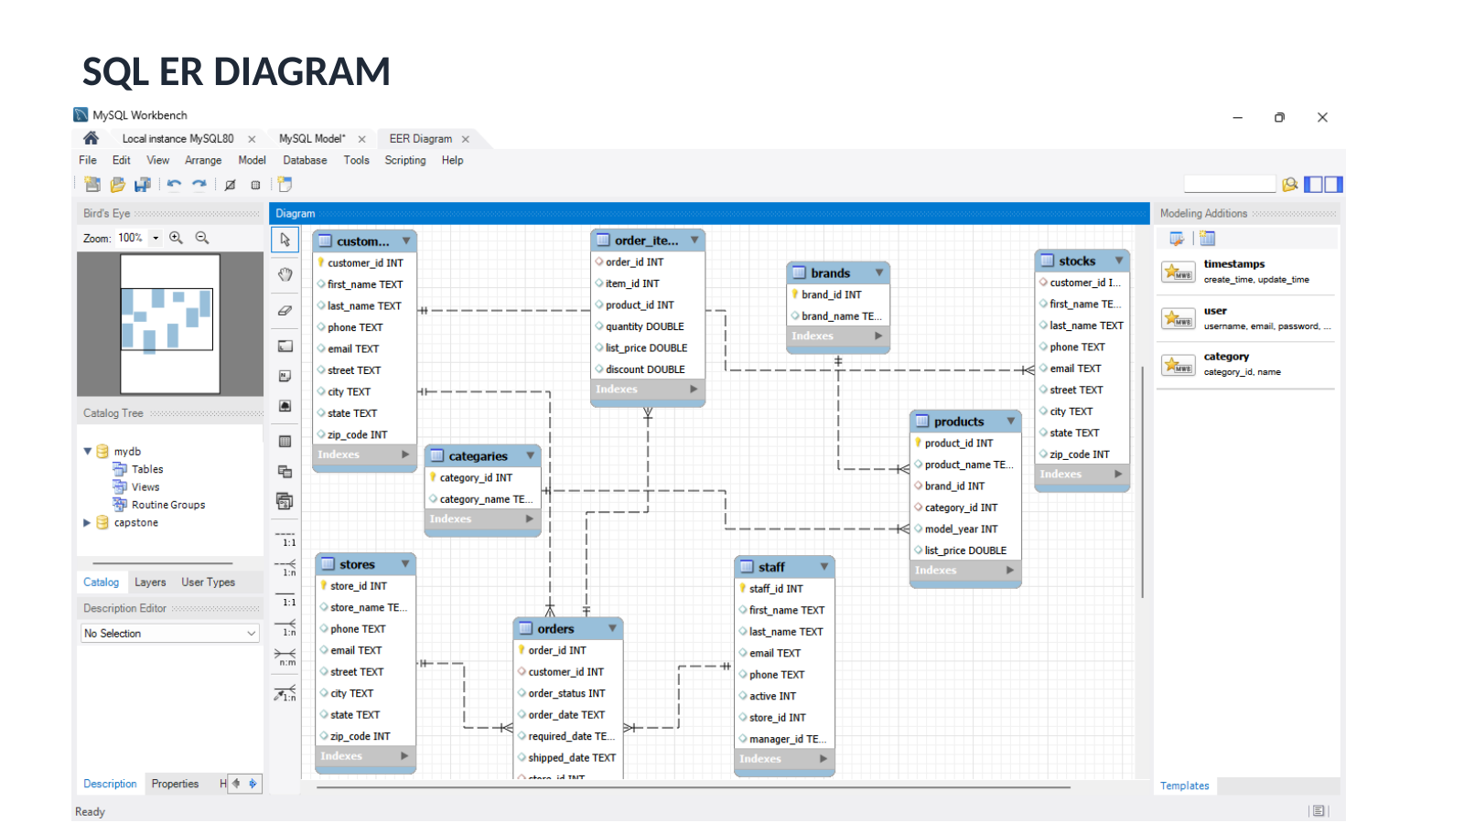
Data Architecture
04
Relational structure connecting customers, orders, products, categories, brands, stores and staff.
RETAIL SALES ANALYTICS • KAVINPRASATH.R

Slide 5
Technical Stack
05
Each tool contributes a distinct stage in the end-to-end analytics pipeline.
X
EXCEL
Q
SQL
P
PYTHON
B
POWER BI
Clean & Audit
Structure & Query
Explore & Analyze
Visualize & Decide
✓ Data cleaning
✓ Duplicate checks
✓ Sorting & filtering
✓ IF / COUNT / SUM
✓ Lookup formulas
✓ Pivot tables
✓ Primary keys
✓ Foreign keys
✓ JOIN
✓ GROUP BY
✓ ORDER BY
✓ Aggregate functions
✓ Pandas
✓ NumPy
✓ EDA
✓ Matplotlib
✓ Seaborn
✓ Business insights
✓ KPI cards
✓ Interactive dashboard
✓ Category analysis
✓ Stock overview
✓ Sales insights
✓ Reporting
RETAIL SALES ANALYTICS • KAVINPRASATH.R

Slide 6
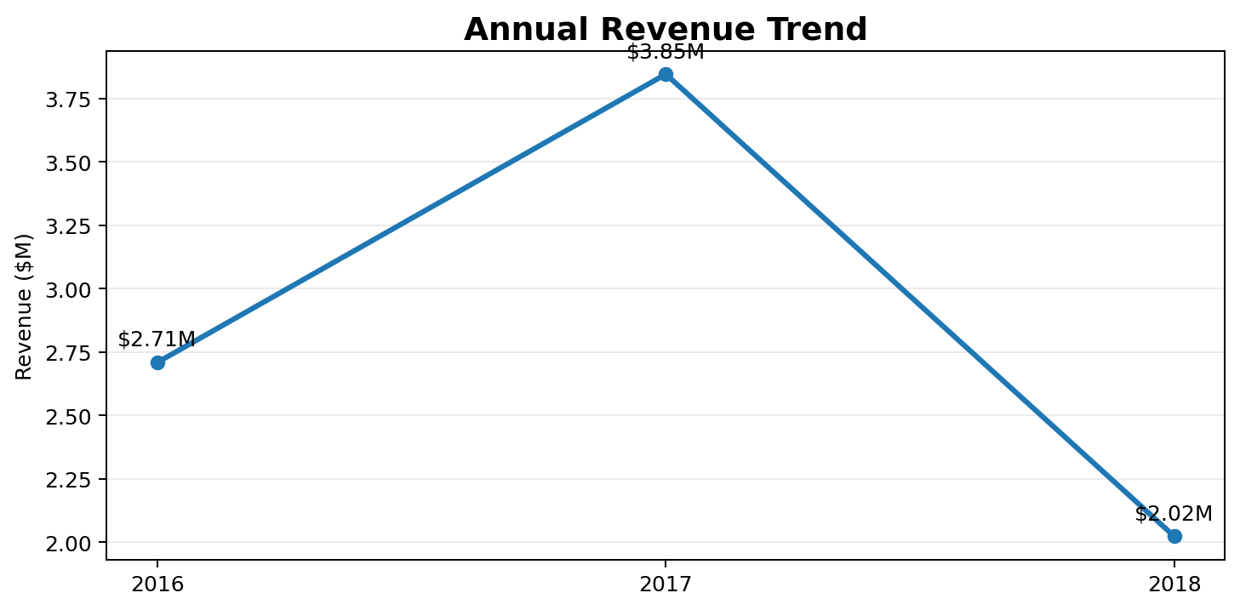
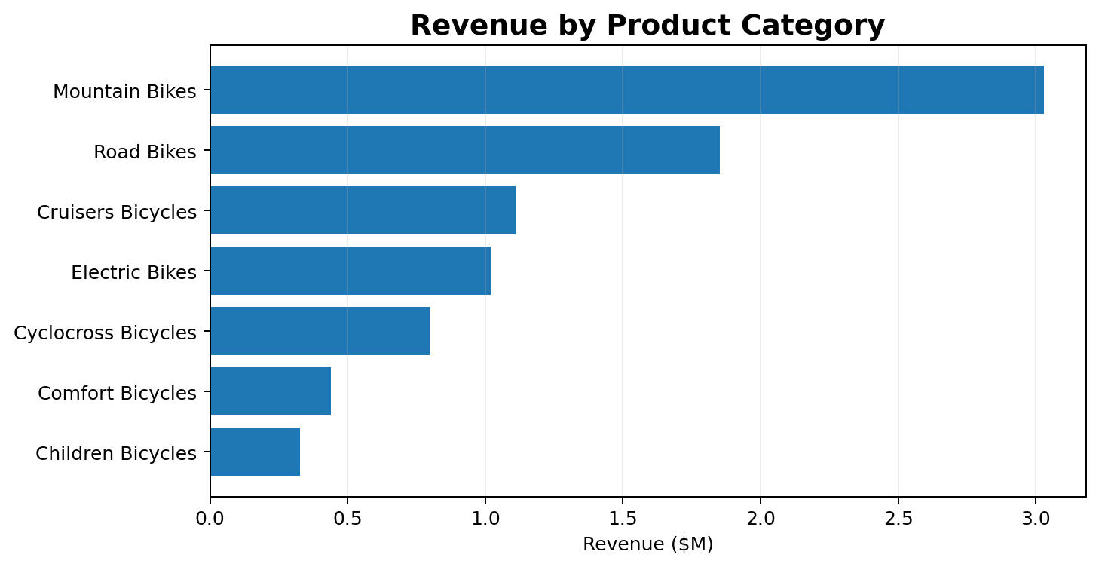
Sales Performance
06
Revenue trend and category mix derived from transaction-level data.
1
$3.85M
M
$3.03M
R
$1.85M
Best year: 2017
Mountain Bikes
Road Bikes
35.3% of revenue
21.6% of revenue
RETAIL SALES ANALYTICS • KAVINPRASATH.R

Slide 7
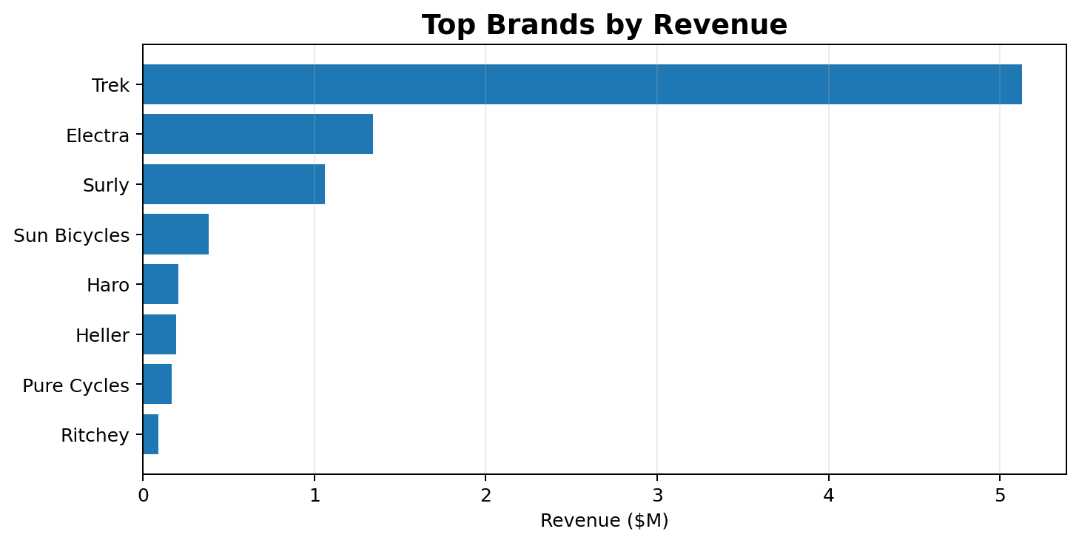
Product & Brand Insights
07
High-value products and brands explain where revenue concentration is coming from.
Top 5 Products by Revenue
Product | Revenue | Units
Trek Slash 8 27.5 - 2016 | $616K | 154
Trek Conduit+ - 2016 | $435K | 145
Trek Fuel EX 8 29 - 2016 | $415K | 143
Surly Straggler 650b - 2016 | $254K | 151
Trek Domane SLR 6 Disc - 2017 | $236K | 43
T
$5.13M
E
2,612
★
$616K
Trek revenue
Electra units
Top product revenue
Leading brand
Strong unit volume
Trek Slash 8 27.5 - 2016
RETAIL SALES ANALYTICS • KAVINPRASATH.R

Slide 8
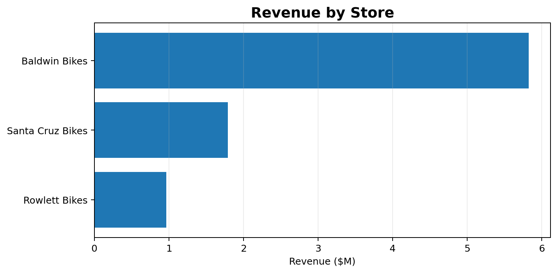
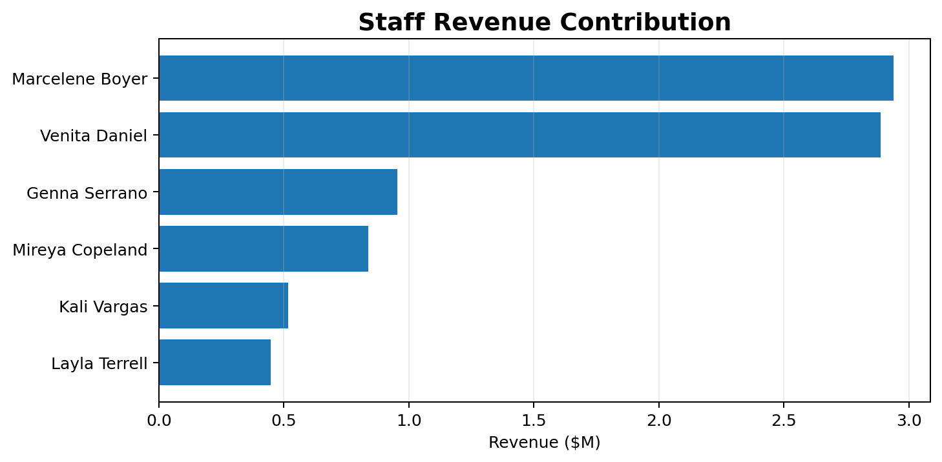
Store & Staff Performance
08
Performance comparison identifies high-contribution locations and sales teams.
S
$5.83M
1
$2.94M
2
$2.89M
Baldwin Bikes
Marcelene Boyer
Venita Daniel
67.9% of revenue
Top staff revenue
Second-highest staff revenue
RETAIL SALES ANALYTICS • KAVINPRASATH.R

Slide 9
Inventory & Customer Insights
09
Operational signals from stock records and order-level customer activity.
INVENTORY
!
307
0
25
S
939
Dashboard low-stock count
Zero-stock records
Stock records
As displayed in Power BI
Source stock file
Store × product rows
CUSTOMER & ORDER BEHAVIOR
$
$5,312
C
1,445
R
9.1%
Average order value
Unique ordering customers
Repeat-customer share
Revenue / distinct orders
Customer IDs in orders
Customers with >1 order
→
Action point
• Prioritize low-stock replenishment while protecting availability of high-revenue products and leading categories.
RETAIL SALES ANALYTICS • KAVINPRASATH.R

Slide 10
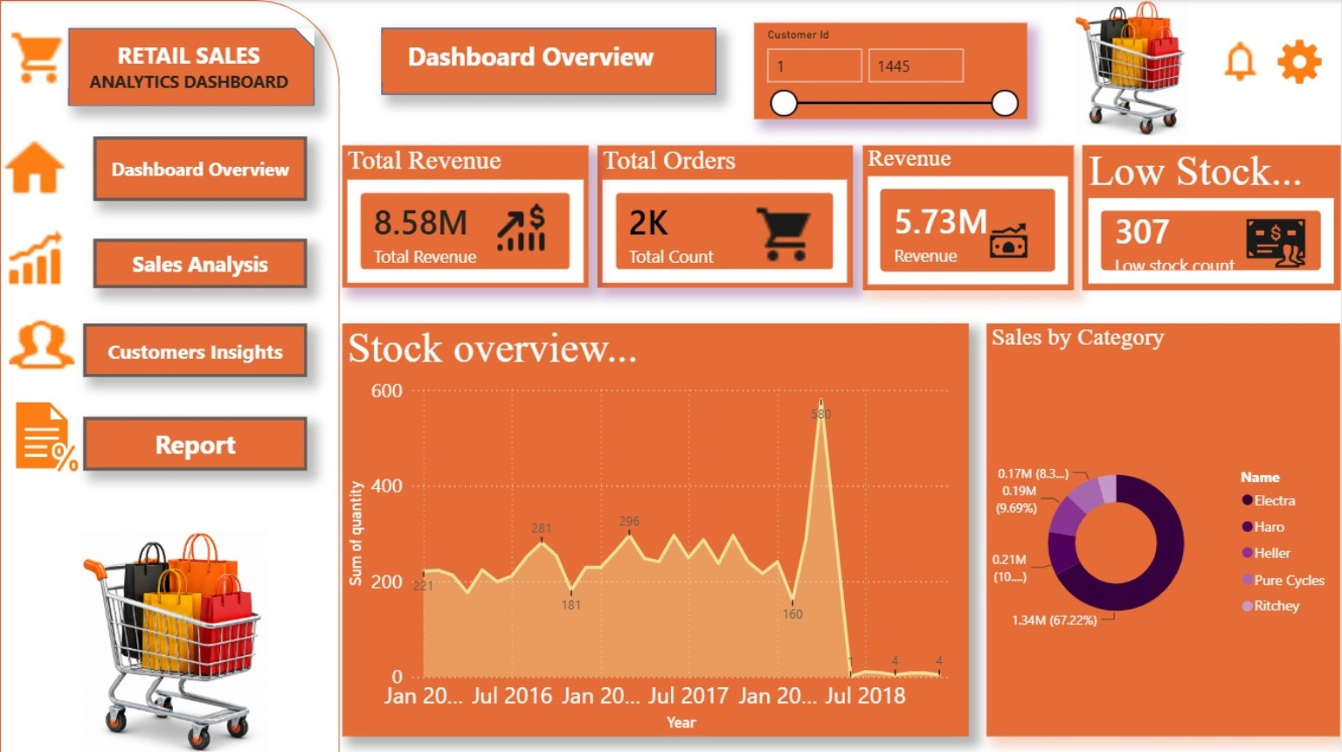
Power BI Dashboard
10
Interactive dashboard view used to communicate KPIs, stock position and sales mix.
RETAIL SALES ANALYTICS • KAVINPRASATH.R

Slide 11
Key Findings & Recommendations
11
Turn the analytical results into practical actions.
01
Revenue concentration
Mountain Bikes lead category revenue; Trek is the strongest brand by revenue.
ACTION • Protect availability and prioritize high-value inventory.
02
Store concentration
Baldwin Bikes contributes the majority of revenue.
ACTION • Study winning practices and replicate them across stores.
03
Sales productivity
Marcelene Boyer and Venita Daniel are the two largest staff contributors.
ACTION • Use top-performer practices for coaching and targets.
04
Inventory risk
Power BI highlights 307 low-stock items.
ACTION • Create replenishment thresholds for fast-moving and high-value SKUs.
RETAIL SALES ANALYTICS • KAVINPRASATH.R

Slide 12
CONCLUSION
✓
End-to-end analytics outcome
$
$8.58M
• Excel establishes a clean and auditable dataset.
• SQL creates a connected relational structure for reliable querying.
• Python reveals sales, product, brand, customer and operational patterns.
• Power BI turns the analysis into an interactive decision-support dashboard.
• Together, the pipeline converts raw retail data into actionable business insight.
Revenue analyzed
#
1,615
Orders analyzed
P
321
Products covered
Thank You
Presented by KAVINPRASATH.R

